Slide 1

Inter-Process Communication
-Ayushi Pandey

Slide 2
Process 1
User space: The memory area where user applications run.
Kernel space: The memory area where the operating system kernel executes.
System calls: Interfaces that allow user applications to request services from the kernel.
System calls act as the bridge between user space and kernel space, ensuring safe and controlled access to system resources.
Process 2
Kernel
Process 3
Process 4

Slide 3
Wrapper Function
Bounds the system call.
Copies all parameters of system call into registers.
Converts name of the system call into its respective number.
printf( )
scanf( )
malloc( )
calloc( )

Slide 4
fork( )
Parent process
Creates a new process by duplicating the calling process.
Parent process: The original process that calls fork( ).
Child process: The new process created by fork( ).
fork( )
Child process
Return values:
0
Child’s pid
-1

Slide 5
What is IPC?
Pipe
FIFO
Message Queue
Signals
Shared memory
Sockets
Definition: Methods that allow processes to communicate and synchronize their actions.
Importance: Essential for resource sharing and cooperation in multitasking environments.

Slide 6
Pipe
Only for related processes
Pipes are usually one-way (unidirectional); data flows in only one direction.
Commonly used to connect the output of one process to the input of another.
Named Pipes (FIFOs): Can be used for communication between unrelated processes and have a name in the file system.

Slide 7
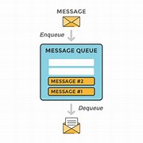
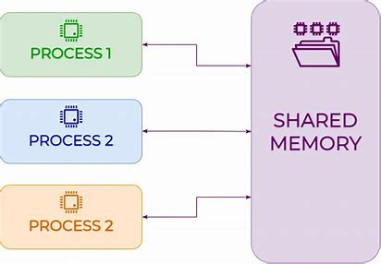
Message Queue
Shared memory
Messages are kept in a queue until processed.
Typically follows FIFO (First In, First Out).
Multiple processes are allowed to access a common memory space.
Often used in real-time applications and large data processing.

Slide 8
Thankyou!

